Slide 1


Blockchain Concepts
Byzantine Generals, Double Spending, Consensus Algorithms, Blocks and Transactions
Svetlin Nakov
Technical Trainer
Academy School of Blockchain
http://kingsland.academy

Slide 2
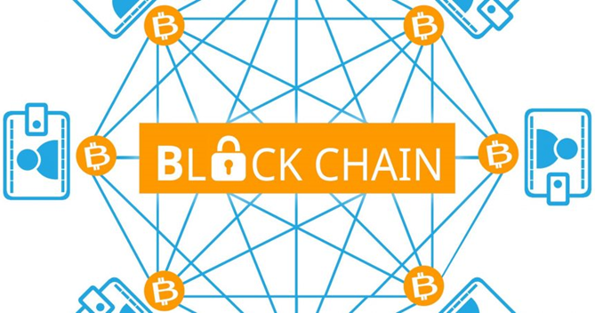

Table of Contents
The Byzantine Generals Problem
Double-Spending Problem
Decentralized Consensus Algorithms
Proof-of-Work / Proof-of-Stake
Blockchain Technology Explained
Blocks, Transactions, Hashes, Chaining
Mining the Next Block, Network Difficulty
Transaction Speed and Transaction Fees

Slide 3
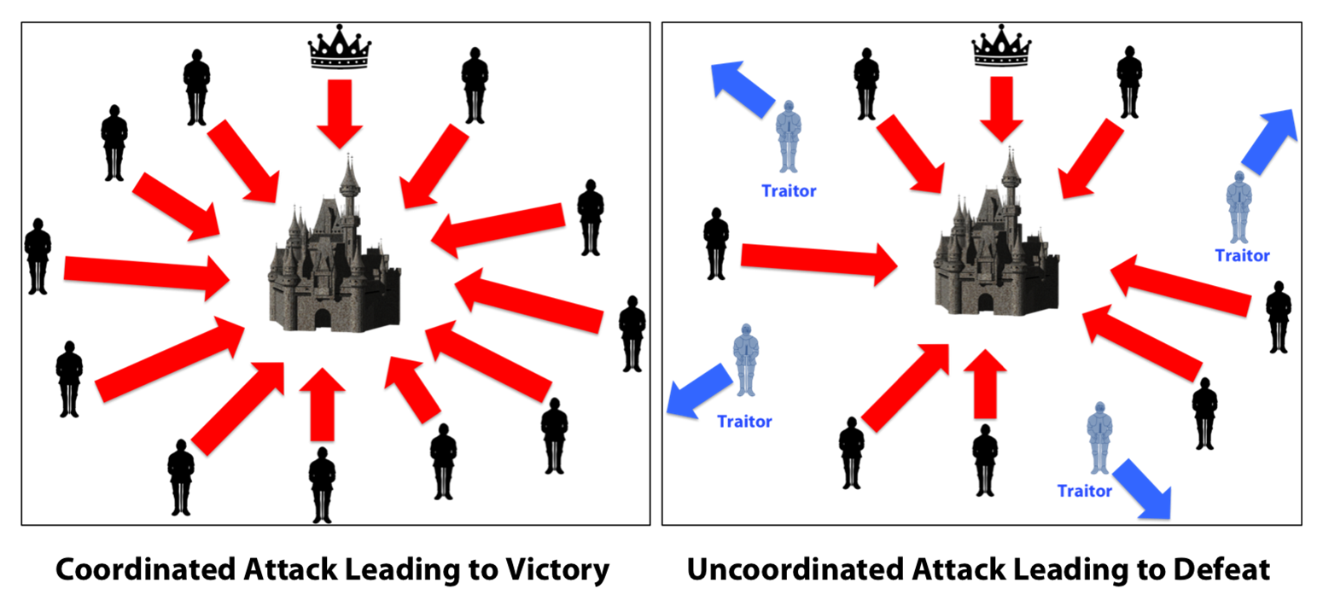
The Byzantine Generals Problem
Decentralized Solution

Slide 4
The Byzantine Generals Problem
An army of few generals want to attack the enemy
Only well coordinated attack in the same time will succeed
The lead general sends a message: the time to attack
The message cannot pass directly to all generals, due to distance
Some generals are loyal and pass the message correctly
Some generals are traitors and pass wrong message
Nobody knows who is loyal and who is traitor
Find an algorithm to send the correct message to all generals

Slide 5
The Byzantine Generals Problem in Blockchain
In blockchain the public / private key cryptography is used
Private key can sign messages
Public keys can verify message signature
In the blockchain the sender addresses are derived from their owner's public key
If a participant sends coins to another participant, the transaction is signed by the sender's private key
Everyone on the network can verify the sender's signature

Slide 6
Public / Private Keys & Blockchain
private key
public key
address
transaction
sign by private key
signature
signed transaction
verify by address key
valid / invalid

Slide 7
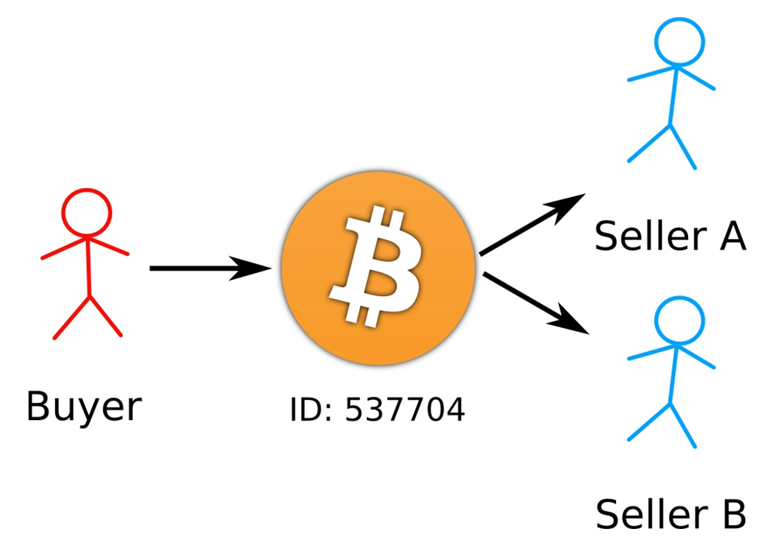
Double Spending Problem
How the Blockchain Solves It?

Slide 8
Double Spending Problem
Double spending problem == spend certain amount twice
Easy to prevent through a central authority (single database)
More complex in decentralized systems like Bitcoin and Ethereum
Blockchain prevents double spending
The blockchain holds signed chain of blocks with transactions
All pending transactions are collected in the network nodes
A single node creates the next block (selected by a consensus)
The next block creator puts the pending transactions (after validation) in the next block (and prevents double spending)

Slide 9
Transactions and Double Spending
Consensus algorithm
Consensus algorithm
Blockchain clients create and sign transactions
Blockchain Network
Selects the winning node (a lucky miner)
Blockchain Node #1
Blockchain Node #7
pending transactions
Transaction A
pending transactions
Transaction B
Blockchain Node #2
Validates the pending transactions and creates the next block
Transaction C
pending transactions
Transaction …
Next (New) Block
Propagate for validation
Transactions are sent to the network
confirmed transactions
Blockchain Node #...

Slide 10

Consensus and Consensus Algorithms
Proof-of-Work / Proof-of-Stake / Others

Slide 11
Why a Consensus Algorithm is Needed?
Consensus algorithms in a blockchain network
Select the winning node to create the next block (in a consensus)
The winning node (winning miner):
Is awarded to mine (create) some new coins (e.g. 12.5 BTC)
Selects the pending transactions to be included in the next block
Creates the next block and propagates it in the network
The entire network validates the new block
Either accept it (when it is valid) or reject it

Slide 12

Consensus Algorithms
Consensus algorithms choose the next block creator
In a fair way, that everyone in the network agrees on
Proof-of-work (PoW) algorithms
Nodes compete to find a solution to a heavy cryptographic puzzle
Used in Bitcoin, Ethereum, Litecoin, Zcash, Monero, Bitcoin Gold
Proof-of-stake (PoS) algorithms
The next creator is selected randomly, proportionally to its stake in the network, used in EOS, Lisk, Tezos, Cardano, QTUM, OmiseGo

Slide 13

Proof-of-Work (PoW)
Proof-of-work (PoW) algorithms
Challenge all nodes to solve a cryptographic puzzle (work)
Requires heavy and expensive computations + equipment + power
Example: find a number nonce, such that SHA256(prev_block_hash + transactions + nonce) < target
The number target is known as "network difficulty"
The node first solved the puzzle is the winner
It creates the next block and takes some coins as award
The solution acts as proof-of-work, verified by the other nodes

Slide 14

Proof-of-Stake (PoS)
Proof-of-stake (PoS) algorithms
Use transaction validators instead of miners
Minor hardware needs and power consumption
A node becomes a validator by locking some coins (stake)
PoS selects the next block creator among all validators
Many flavors of proof-of-stake → many PoS consensus algorithms
Select random next validator / select several candidates and perform voting on their proposed chains to select one of them

Slide 15
Blockchain Technology Explained
Blocks, Transactions, Hashes, Chaining

Slide 16

Blockchain == Chain of Data Blocks
Block #0 (genesis block)
Block #1
Block #3
timestamp
block_hash
timestamp
block_hash
timestamp
block_hash
prev_hash
nonce
prev_hash
nonce
prev_hash
nonce
all_transactions_hash
all_transactions_hash
all_transactions_hash
transaction #1
hash
transaction #1
hash
transaction #1
hash
transaction #2
hash
transaction #2
hash
transaction #2
hash
transaction #3
hash
transaction #3
hash
transaction #3
hash
…
…
…

Slide 17
Blocks
In blockchain the blocks are created by the miners / validators
Bitcoin blocks: https://blockchain.info/blocks
Ethereum blocks: https://etherscan.io/blocks
Each block holds a set of transactions
Block time == the time between two blocks
From few seconds to few hours
Bitcoin: average block time = 9-10 minutes
Ethereum: average block time = 12-14 seconds
Block #3536323
timestamp
block_hash
prev_hash
nonce
all_transactions_hash
transaction #1
hash
transaction #2
hash
transaction #3
hash
…

Slide 18
Transactions
Transactions hold information about fund transfers
Transaction
Input address | Value
1EnimyBtFhnznMPVsAjtF… | 1.25
3QeQh2EhM16cv2Lf15Еz… | 0.25
1EER58rEaxnSE5TTrtiKr7i… | 0.50
Output address | Value
1A76Hhd7ahsHa5rFGat6… | 1.80
3Mgh5G8HhsOJs68pIgsB… | 0.15
Total outputs: 1.95
Total inputs: 2.00
Transaction fee = 2.00 - 1.95 = 0.05

Slide 19
Mining the Next Block
Transaction Speed and Fees

Slide 20
Mining the Next Block
Consensus algorithm
Consensus algorithm
Blockchain clients create and sign transactions
Blockchain Network
Selects the winning node (a lucky miner)
Blockchain Node #1
Blockchain Node #7
pending transactions
Transaction A
pending transactions
Transaction B
Blockchain Node #2
Validates the pending transactions and creates the next block
Transaction C
pending transactions
Transaction …
Next (New) Block
Propagate for validation
Transactions are sent to the network
confirmed transactions
Blockchain Node #...

Slide 21


Transaction Fees and Priorities
Each block can hold a limited set of transactions
Only a subset of the pending transactions are mined
Limited by the network block size
The others are left for the next blocks
Miners decide which transactions to include in each block
Based on their fee and priority
The fee is assigned by the sender
The priority increases with the transaction age

Slide 22
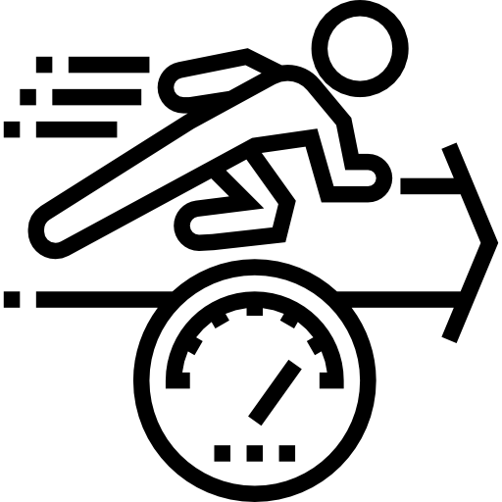
Transaction Speed
Transaction speed depends dramatically on the fee
High-fee transactions are processed faster
Small-fee transactions are processed slower
Some transactions are never processed (e.g. no fee)
Blockchain networks mine blocks at different speed
Bitcoin users may pay very high fees (hundreds of dollars) and wait for many hours, see https://bitcoinfees.earn.com
Ethereum transactions run faster, within minutes, with lower fees
Some networks have almost real-time transactions

Slide 23
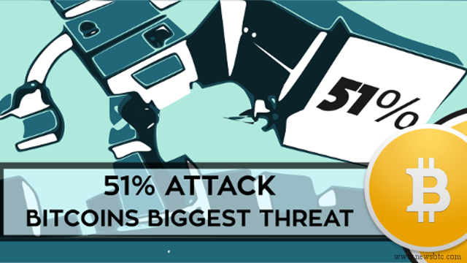
The 51% Blockchain Attack

Slide 24
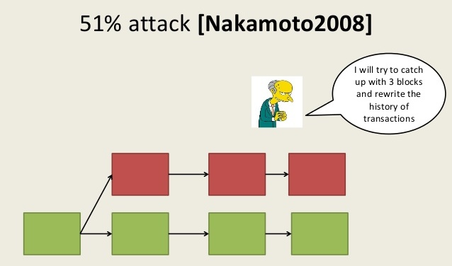
The 51% Attack
Attackers holding more than 50% of the power could potentially reverse-back transactions (and double-spend money)

Slide 25
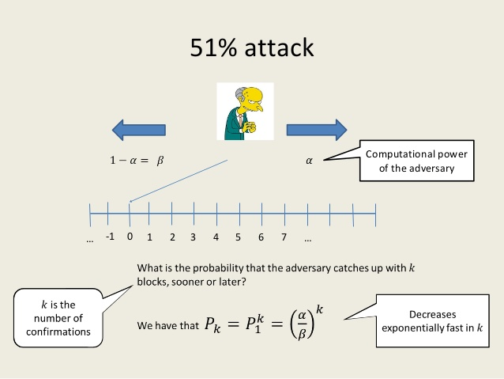
The 51% Attack and Confirmations Count

Slide 26

Summary
Blockchain is distributed ledger with distributed consensus
Blockchain solves the Byzantine Generals Problem + Double Spending Problem
Public / private key cryptography + consensus algorithms
Distributed consensus algorithms
Proof-of-work (PoW) and proof-of-stake (PoS)
Blocks are created by miners, hold transactions
Transactions have senders, recipients, amounts, fees
Transaction speed depends on the fees

Slide 27
Blockchain Concepts
http://www.kingsland.academy

Slide 28
Resources
Byzantine generals problem –
Double spending problem –
Consensus algorithms –
Proof-of-work –
Proof of stake – https://github.com/ethereum/wiki/wiki/Proof-of-Stake-FAQ
Blockchain blocks –
Blockchain transactions –
The 51% Attack –

